Slide 1
Variables & this Pointer in C++ Md. Alamgir Hossain Senior Lecturer, Dept. of CSE, Prime University Mail: alamgir.cse14.just@gmail.com YouTube: https://www.youtube.com/alamgirhossaincse Blog: https://alamgirhossainjust.blogspot.com/

Slide 2
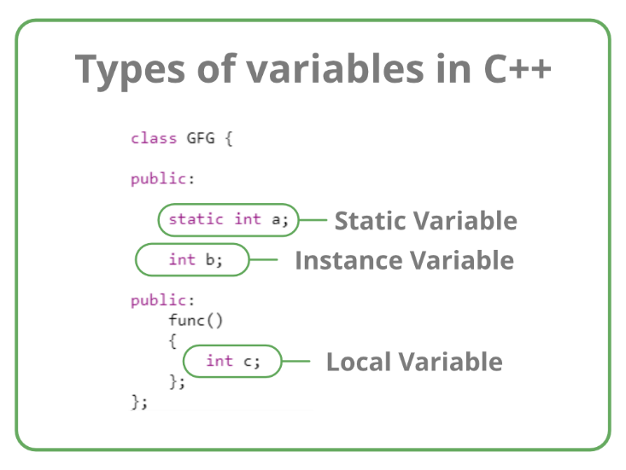
Types of Variables (Based on Scope of Variables)

Slide 3
Local Variable
A variable defined within a block or method or constructor is called local variable.
These variables are created when the block is entered or the function is called and destroyed after exiting from the block or when the call returns from the function.
The scope of these variables exists only within the block in which the variable is declared. i.e. we can access these variables only within that block.
Initialization of Local Variable is Mandatory.

Slide 4
Instance Variable
Instance variables are non-static variables and are declared in a class outside any method, constructor, or block.
As instance variables are declared in a class, these variables are created when an object of the class is created and destroyed when the object is destroyed.
Unlike local variables, we may use access specifiers for instance variables. If we do not specify any access specifier then the default access specifier will be used.
Initialization of Instance Variable is not Mandatory.
Instance Variable can be accessed only by creating objects.

Slide 5
C++ Static Keyword
In C++, static is a keyword or modifier that belongs to the type not instance.
So instance is not required to access the static members.
In C++, static can be field, method, constructor, class, properties, operator, and event.
All the data members in a static function must be static.

Slide 6
Advantages of C++ Static Keyword
Memory efficiency: Now we don't need to create an instance for accessing the static members, so it saves memory.
Moreover, it belongs to the type, so it will not get memory each time when the instance is created.
A field which is declared as static is called static field. Unlike instance field which gets memory each time whenever you create object, there is only one copy of static field created in the memory. It is shared to all the objects.

Slide 7
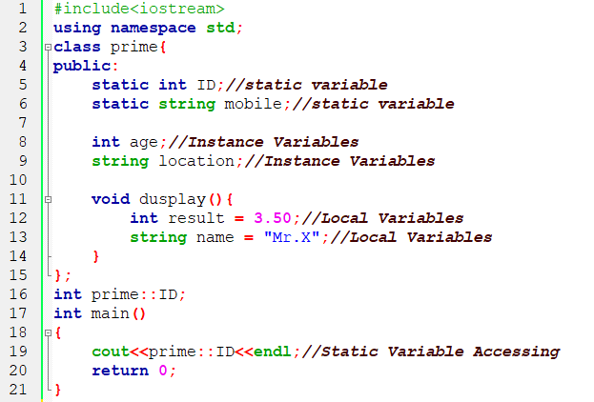
Example of Different Types Variable

Slide 8
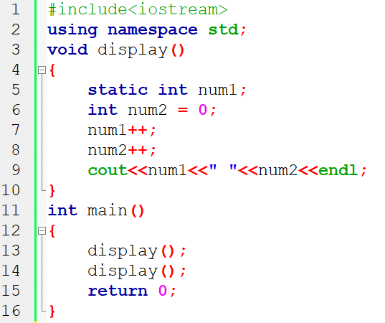
C++ Static Function

Slide 9
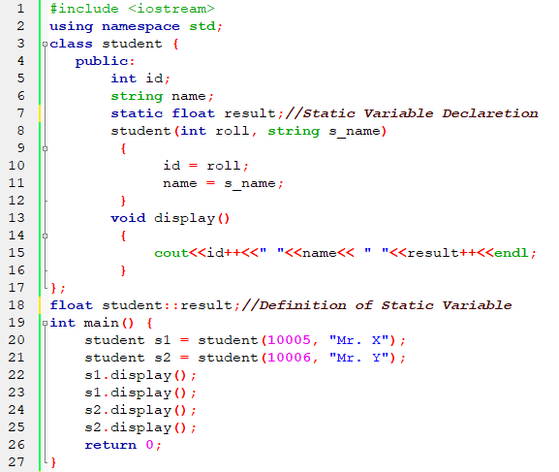
C++ Static Field

Slide 10
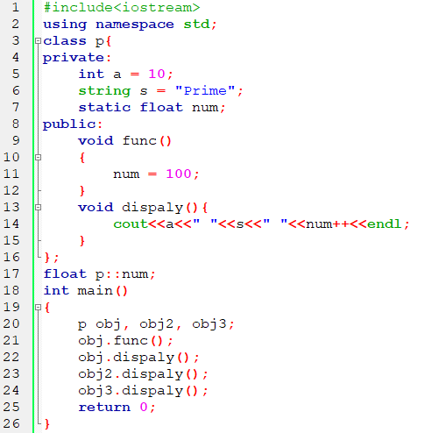
Value Initialization in C++ Static Variable

Slide 11
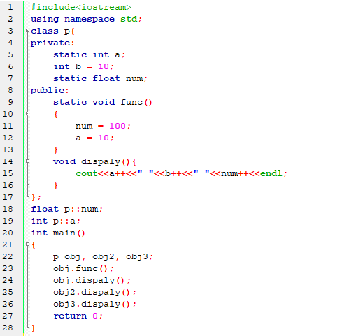
Static Member Function

Slide 12
C++ this Pointer
In C++ programming, this is a keyword that refers to the current instance of the class. There can be 3 main usages of this keyword in C++.
It can be used to pass the current object as a parameter to another method.
It can be used to refer current class instance variable.
It can be used to declare indexers.

Slide 13
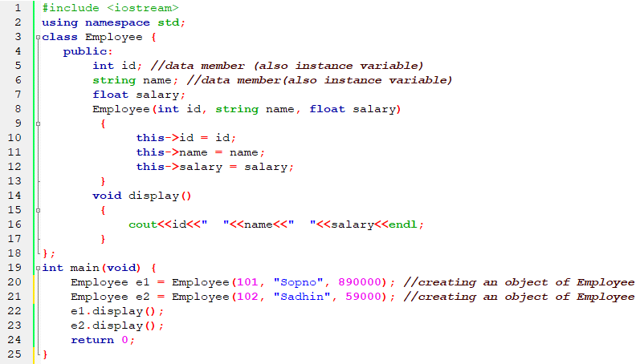
Example of C++ this Pointer

Slide 14
Thank You

